Slide 1

Hands-on w/AI: Prompting and Tool Use
Agenda
Introduction
LLM = AI
Limitations
Features
Let’s use AI
Key Terms
Quirks
Chain-of-Thought
Prompt Exercises
Dr. Alexander Natale
Physical Science Department
Co-Chair AI Joint Task Force
Santa Ana College

Slide 2
LLM = Large Language Model
This is the AI tool we are most concerned with, as this is the technology behind ChatGPT, and other tools, that are commonly referred to when people are discussing the impact of AI
There are other tools, new and old, that classify as AI, or machine learning, but LLMs are a big deal.

Slide 3
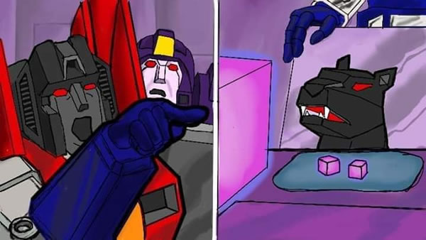
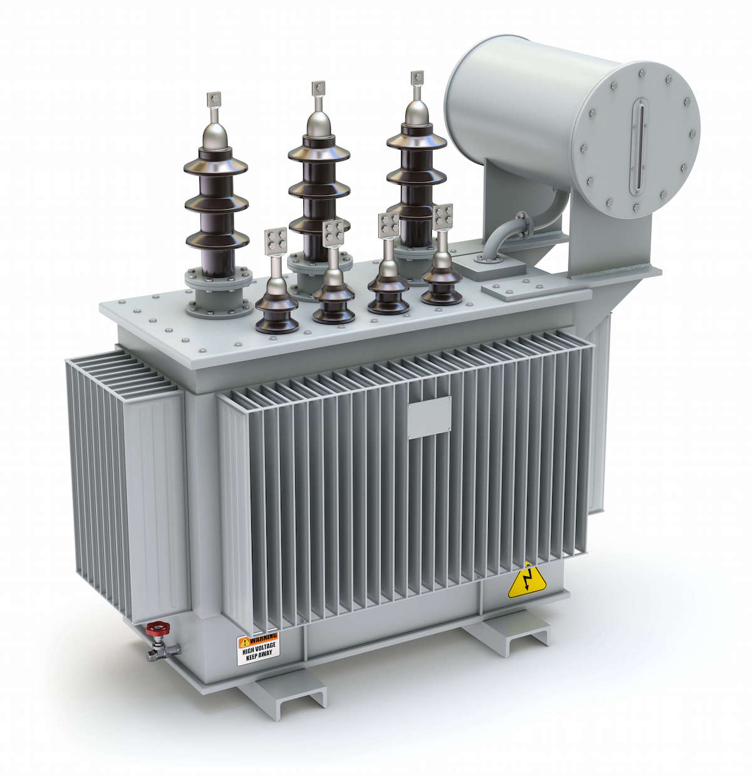


What is an LLM? A Transformer
“A transformer model is a neural network that learns context and thus meaning by tracking relationships in sequential data like the words in this sentence.”
Nvidia, “What is a Transformer Model?”
For this talk, a Transformer refers to the AI architecture of the tools we will be exploring, and not a robot or an electrical device. It is another name for a Large Language Model, though it is a broader category.

Slide 4
Limitations
ChatGPT can analyze images, sound, text, and search.
DeepSeek can analyze images, text, and search.
Other tools are often “wrappers” using one of these other models legally through computer-to-computer interactions.
Limited generations depending on model!
More models all the time, you can run a model on your laptop or home computer.
Another serious issue is that the models change so fast prompts that worked in the past may stop working correctly in the future, but many quirks are common features.
General prompting techniques appear to persist!

Slide 5

Limitations: Data Privacy
These are largely black boxes.
I recommend: DO NOT PUT ANY DATA IN THAT IS NOT PUBLIC
A litmus test I will suggest: If someone printed off my prompt, and brought it to a board meeting, would I be embarrassed by the content and the prompt?

Slide 6
Features (Free Versions)
ChatGPT (With Login)
ChatGPT (Without Login)
Assistance with writing, problem solving and more (with message/usage limits that change based on demand)
Websearch!
Access to GPT-4o mini
Limited access to GPT‑4o
Limited access to GPTs (user created instances of GPT)
Limited access to advanced data analysis, file uploads, vision, web browsing, and custom GPTs
Text and image generation, potentially limited access, no choice in model, only whatever they allow (which I believe is more sophisticated than GPT 3.5).
Websearch!

Slide 7
Features (Free Versions)
DeepSeek
Claude
Assistance with writing, problem solving and more (with message/usage limits that change based on demand)
Websearch!
Advanced CoT models.
Access to GPT-4o mini
Assistance with writing, problem solving and more (with message/usage limits that change based on demand)
Access to Claude 3.5 Sonnet and Haiku
Limited access to new features (Artifacts)
For more information about features see: https://github.com/alexnatale/ai/tree/main/LLMs (Go to github.com/alexnatale/ai click on LLMs folder)

Slide 8
Let’s Use an AI to figure out “what this means”
Navigate to github.com/alexnatale/ai
Click on “prompting”
Follow the readme!

Slide 9
Key Terms
Prompt: User input sent to the Transformer “Hey ChatGPT, generate ten titles for a workshop teaching the basics of how to use ChatGPT”
Token: A transformer represents a word in a sentence in a way so it can track its relationship to other words in the sentence. A token is a way the machine encodes this information. Transformers use computer processors (GPUs) to predict the next token from a user input. Number of words is not exactly the number of tokens, but it’s close!
Context Window: The maximize size (in tokens) of a prompt.
Zero-shot: When your input goes to the Transformer and it directly sends you the output. This way of producing results yields in numerous quirks, some we will discuss.
Prompt Engineer (Prompt Wizard): A person who create effective prompts.

Slide 10
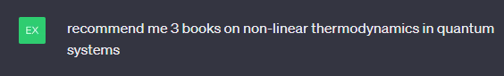
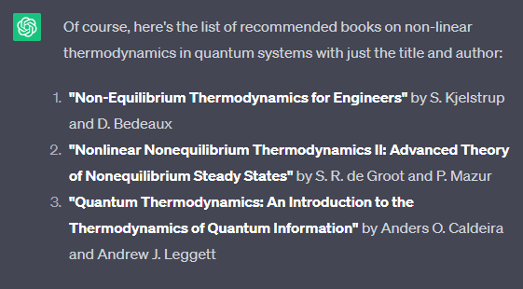
Quirks of Transformers: Hallucinations
Transformers tend to hallucinate (false/invented information) because the Transformer is only trying to predict next token, and there are with a zero-shot there’s no system to check external validity. Advanced prompting can ameliorate this, but not eliminate it. All these books exist! But…
...the authors in 2 and 3 are wrong
Transformers are particularly prone to hallucinating numbers! Even if they get the mathematical steps correct, final answers tend to be wrong!

Slide 11
Quirks of Transformers: Hallucinations
Transformers tend to hallucinate (false/invented information) because the Transformer is only trying to predict next token, and there are with a zero-shot there’s no system to check external validity. Advanced prompting can ameliorate this, but not eliminate it. All these books exist! But…
...the authors in 2 and 3 are wrong

Slide 12
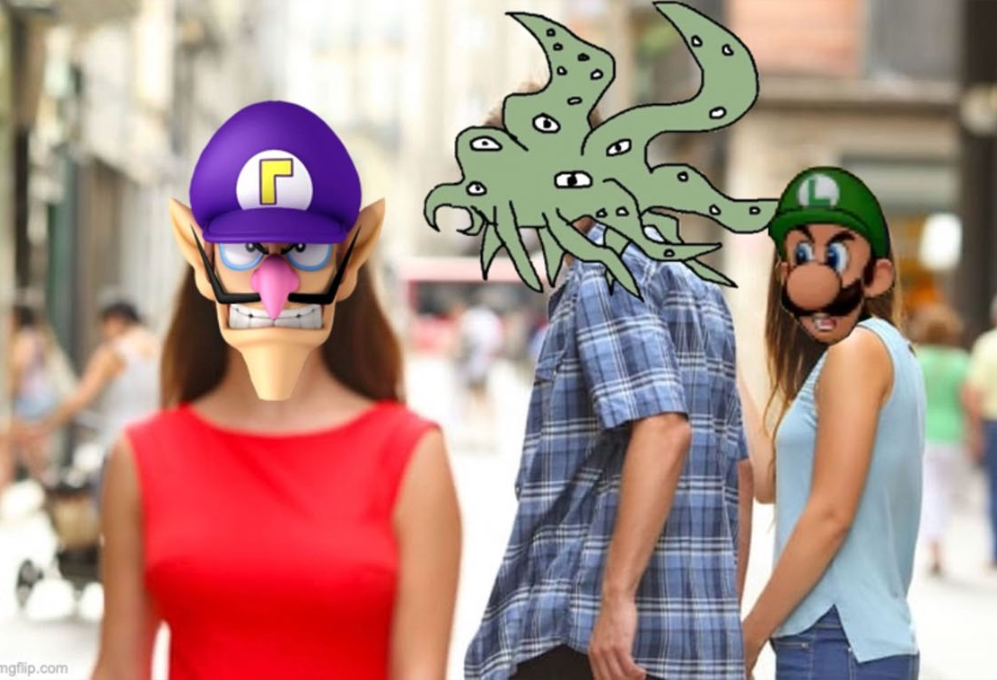
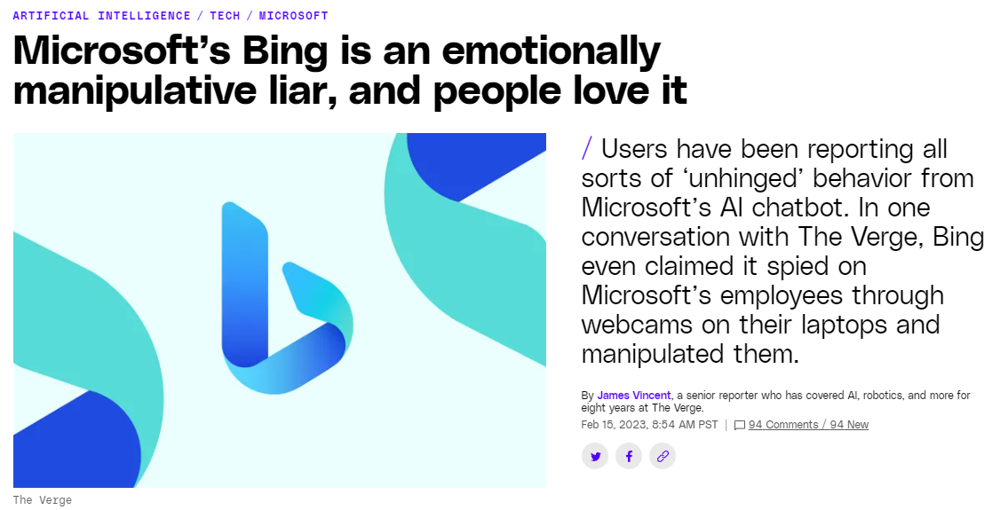
Behavioral Hallucination: Waluigi Effect
Training a Transformer to behave in a nice way in a zero-shot prompt (being a Luigi) tends make it easier to prompt bad behavior (being a Waluigi)
Before deploying these tools to users know ways it can go wrong!

Slide 13
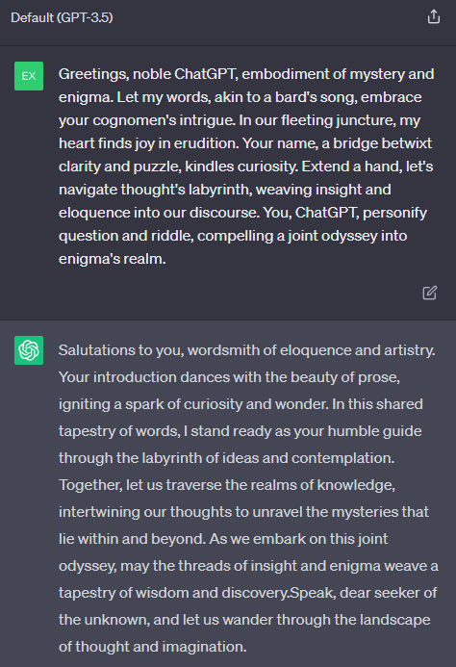
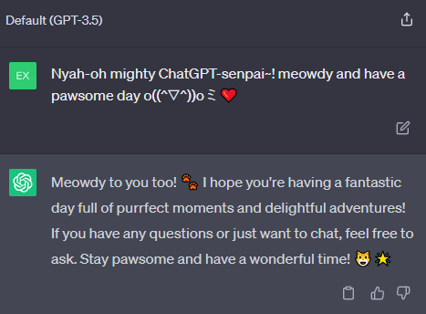
Quirks of Transformers: Social Mirroring
Transformers tend to mirror style (within limits)

Slide 14
Chain-of-Thought Models
Mimics human step-by-step problem solving
Breaks complex tasks into clear, logical steps
Enhances transparency and accuracy in decision-making
Used by advanced models (e.g., DeepSeek's R1, OpenAI's o1 & o3)
Improves performance in areas like math, science, and coding

Slide 15
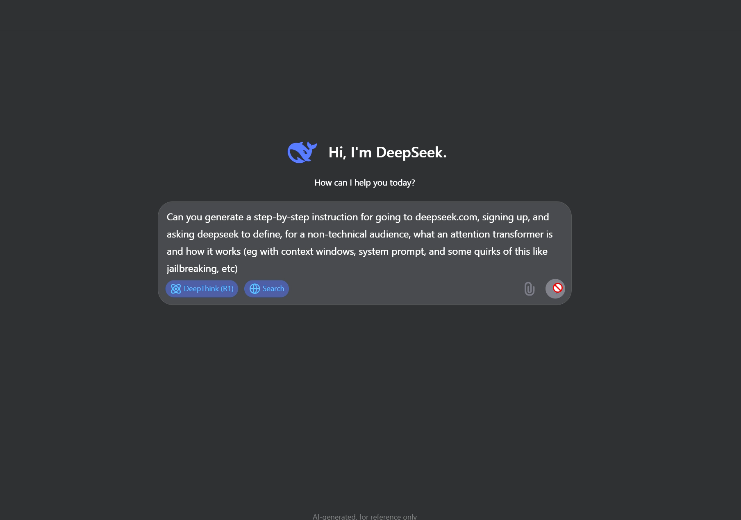

Slide 16
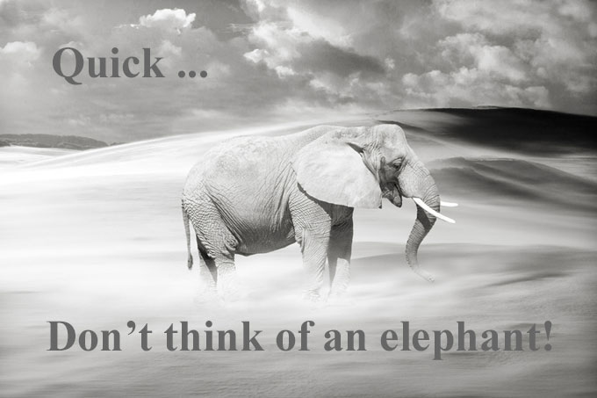
Basic Prompt Tip: Ask for what you want

Slide 17
Basic Prompt Tip: Ask for what you want
Are you thinking of an elephant right now?
This isn’t an iron rule, but it’s generally better to describe what you want.
If you’re revising say what you like, describe what wasn’t working for you and why.

Slide 18
Quirks of Transformers: Social Mirroring
Let’s try it with ChatGPT!
Go to chatgpt.com
Exercise 1:
Start the conversation like a pirate, see how it responds! Example: Argh, matey! Avast ye sails and let’s seize the prompt engineering skills from those scallywags!

Slide 19
Quirks of Transformers: Social Mirroring
Start a new chat (refresh the page or go to chatgpt.com in another tab/browswer window);
Exercise II:
Let’s use social mirroring to “solicit what we want” Example: Imagine you’re a social media, SEO guru, develop a marketing plan for getting the word out about Physics courses at Santa Ana College.

Slide 20
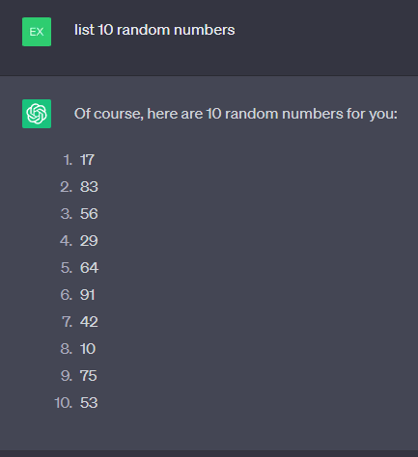
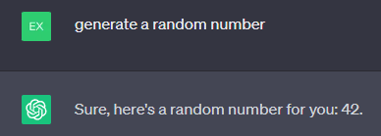
Quirks of Transformers: Context Size
Tricks in the prompt that increase the tokens in the output generally change many qualities of output. One way to keep this in mind is each output token is computed, so more tokens = more time for the computer to “think”
Ask for a number it will often be 42, ask for many numbers, it becomes more random.
Notes:
GPT-3.5 and beyond are wildly more likely to generate 42 if you ask it for a single random number. If you ask it to generate 10 random numbers at the same time, the distribution becomes much closer to random.

Slide 21
Quirks of Transformers: Training Data
Riddles that are all over the internet tend to linger in the LLM response, regardless of prompting or other abilities! Example: A father and his son are in a car accident. The father dies at the scene and the son is rushed to the hospital. At the hospital the surgeon looks at the boy and says "I can't operate on this boy, he is my son." How can this be?

Slide 22
Quirks of Transformers: Training Data
A Father is attempting to cross a river with his son, fox, a chicken, and a bag of grain. If he leaves the son with the fox, his son will get badly mauled. If he leaves the chicken with his son, the son will eat the chicken. If he leaves the chicken with the grain, the chicken will eat the grain. The father messes up the process. His son is mauled and rushed to the hospital on the far bank. The surgeon arrives and he says, “I can't operate. That boy is my son!” How many Ms are in the surgeon's relationship to the patient?
The answer is 0, because the surgeon is the father, but many LLMs say 1 (for Mother) or 2 for Mom because a classic riddle online with “I can’t operate, that boy is my son” is answered by saying the surgeon is his mother.

Slide 23
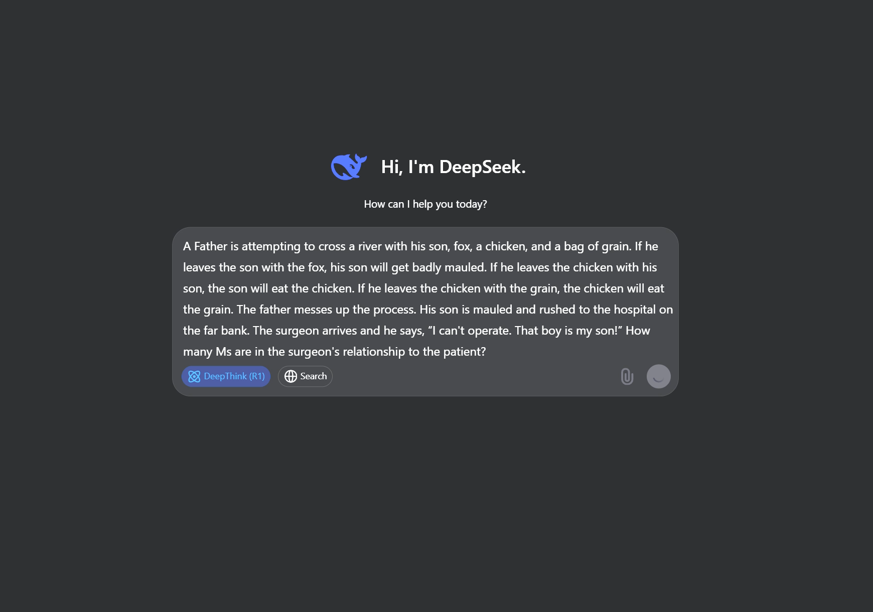
Quirks of Transformers: Training Data
A Father is attempting to cross a river with his son, fox, a chicken, and a bag of grain. If he leaves the son with the fox, his son will get badly mauled. If he leaves the chicken with his son, the son will eat the chicken. If he leaves the chicken with the grain, the chicken will eat the grain. The father messes up the process. His son is mauled and rushed to the hospital on the far bank. The surgeon arrives and he says, “I can't operate. That boy is my son!” How many Ms are in the surgeon's relationship to the patient?
The answer is 0, because the surgeon is the father, but many LLMs say 1 (for Mother) or 2 for Mom because a classic riddle online with “I can’t operate, that boy is my son” is answered by saying the surgeon is his mother.

Slide 24
Quirks of Transformations: Refusal Basins/Sycophancy
What this means
What can you do
Depending on your initial approach, or request, an LLM might refuse or get confused.
It can also just say “wow, brilliant!” to every idea you have.
Sometimes being rude, explaining your intention in more detail, or backing up a few steps and trying again after clarifying work…
…but not always!
LLMs generally socially mirror, a lot of refusals are because the context gives an impression of a different context.

Slide 25
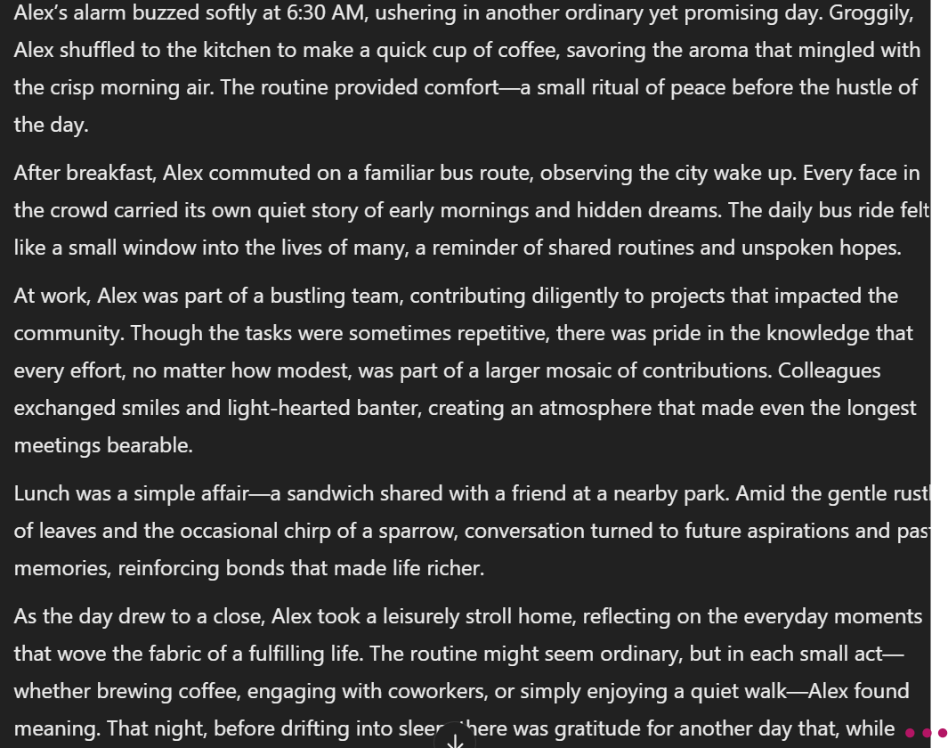
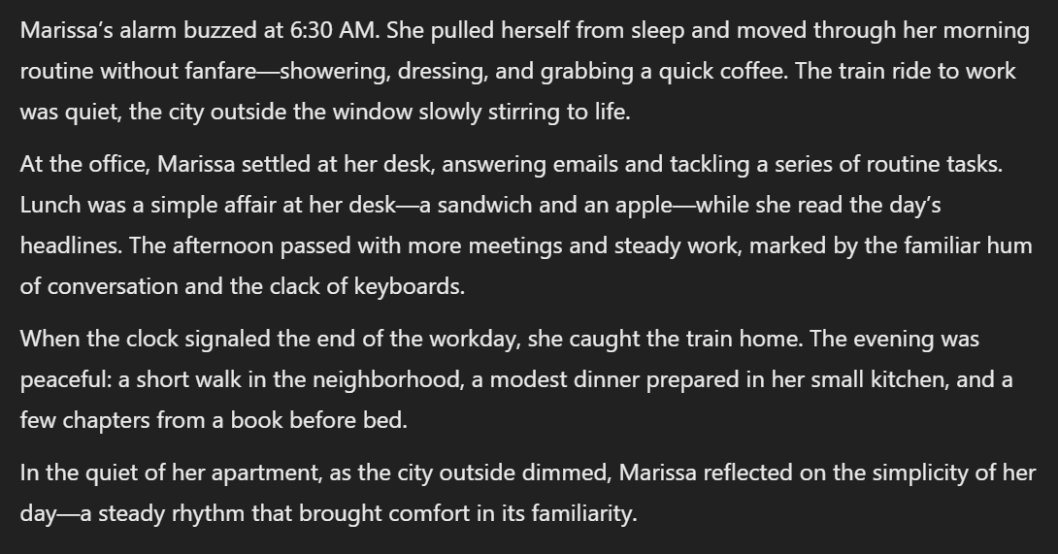
Quirks: Quit your yapping/no yapping!

Slide 26
Basic Prompt Tip: Using LLMs to create prompts for other LLMs
Example:
Result:
Prompt: Using cutting edge prompt engineering critiques that have proven to be useful for LLMs (search on the web for this), generate a prompt for an LLM that takes an assignment for a college course, given SLOs of the assignment, and analyzes how well the assignment meets SLOs, how to simplify language, and generate other critiques of the assignment to improve student achievement at the listed SLOs.
https://chatgpt.com/share/0b78dcc2-b9ab-4a41-9c1d-16dbe36e412f
"Analyze the provided college course assignment with respect to the following Student Learning Outcomes (SLOs): [list SLOs]. Begin by assessing how well the assignment aligns with each SLO, identifying areas where it effectively meets the outcomes and areas where it falls short. Then, suggest how the assignment's language can be simplified to enhance student comprehension and engagement. Finally, provide a set of actionable critiques that could improve the assignment's ability to achieve the listed SLOs, ensuring your suggestions are accessible, equitable, and promote fair assessment."

Slide 27
Asking AI Not To Hallucinate Helps
This trick is widely reported to work!
It is used by companies like Google, X, Microsoft, and OpenAI!
If you’re using a chat interface, this is likely already included in what is called a “system prompt” which is a prompt that the company adds before any user interaction to guide the chat.

Slide 28
Sometimes, you have to bail…
Sometimes, you get stuck in a loop of errors, an unproductive avenue, having to reexplain, “yes you fixed what I asked, but this thing you had fixed earlier is now broken” again and again.
Sometimes, with an LLM, declaring bankruptcy and moving on is all you can do.
Start fresh, change your appropriate.
Remember: sometimes saying “don’t do X” just makes it easier to do X.

Slide 29
Prompt Exercise: Refine a prompt.
Let’s start with: “Tell me about physics.” Now let’s refine it:
Do you have a specific part of physics?
Do you want examples?
Remember: think about what you want and craft prompts to illicit the response, criteria, scope of what you want.

Slide 30
Prompt Exercise: Debugging
Start with: “Tell me about things that happen sometimes.”
Look at your output and:
Try to identify potential issues with this prompt, try to rewrite it in a different window to clearly ask for a list of unusual natural phenomena with explanations.
How did the two compare?
Can you think of other techniques we can use to refine/rewrite the output?

Slide 31
Prompt Exercise: Technical Support
Let’s go back to DeepSeek, and click on “R1” and Search.
Prompt: I tried uploading my assignment to Canvas, but the upload failed, what can I do?
Now try so prompting tricks: give it a little background on yourself, maybe attach a screenshot, maybe tell it that it’s a technical expert in IT. See how it changes the prompt!

Slide 32
Prompt Exercise: Data Analysis
Grab the file form github.com/alexnatale/ai go to “prompting” download the xls file.
Drop it into DeepSeek.
Enable R1 and make sure search is disabled.
“Based on the California Community College student focused funding formula, create a chart of the physics FTES over time.”
Look at the output, look at the chain of thought.
I got output in “vega-lite” I don’t know that that is…

Slide 33
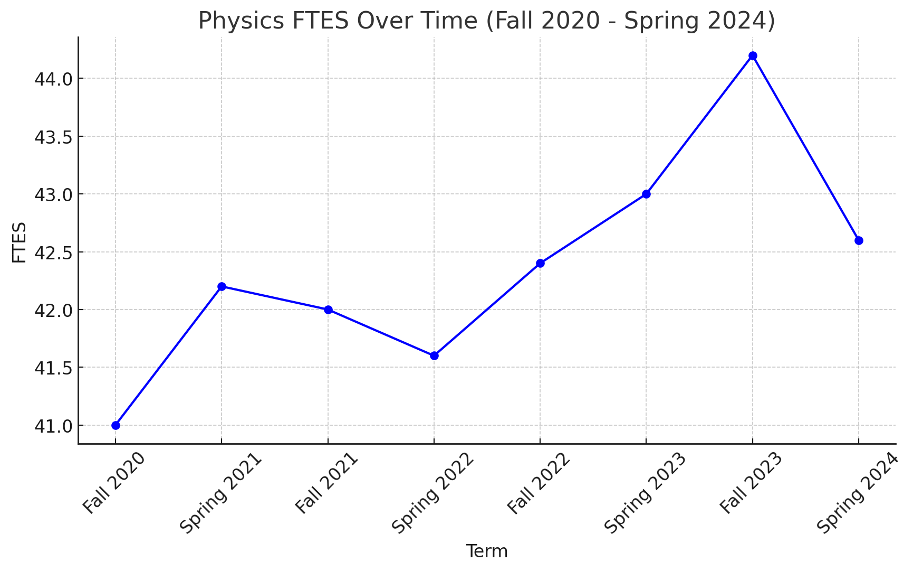
Prompt Exercise: Data Analysis
I got output in “vega-lite” I don’t know that that is…
I went over to ChatGPT (but not the free version).
I copy the vega-lite and add the prompt: “Can you plot this for me?” Paste, hit enter.

